Slide 1
Thermal Flow Technology
No Longer a “Black Box”
Gilson Engineering Sales: Webinar
April 22nd, 2020

Slide 2
“We are stuck with technology when what we really want is just stuff that works.”
– Douglas Adams, Author

Slide 3
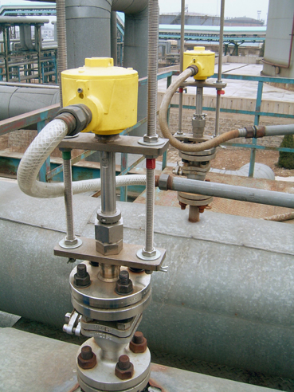
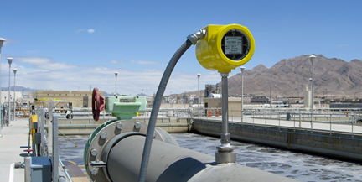
Industrial Thermal Technology Has Been Around for Over 50-Years
Flow/Level Switches introduced in the 60’s
Flow Meters introduced in the 80’s

Slide 4
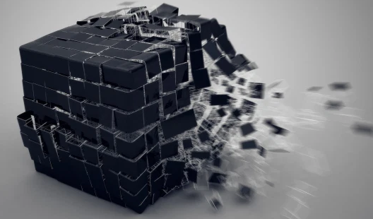
No Longer a Black Box when Understood and Properly Applied

Slide 5
The Basics of Thermal Sensor Technology

Slide 6
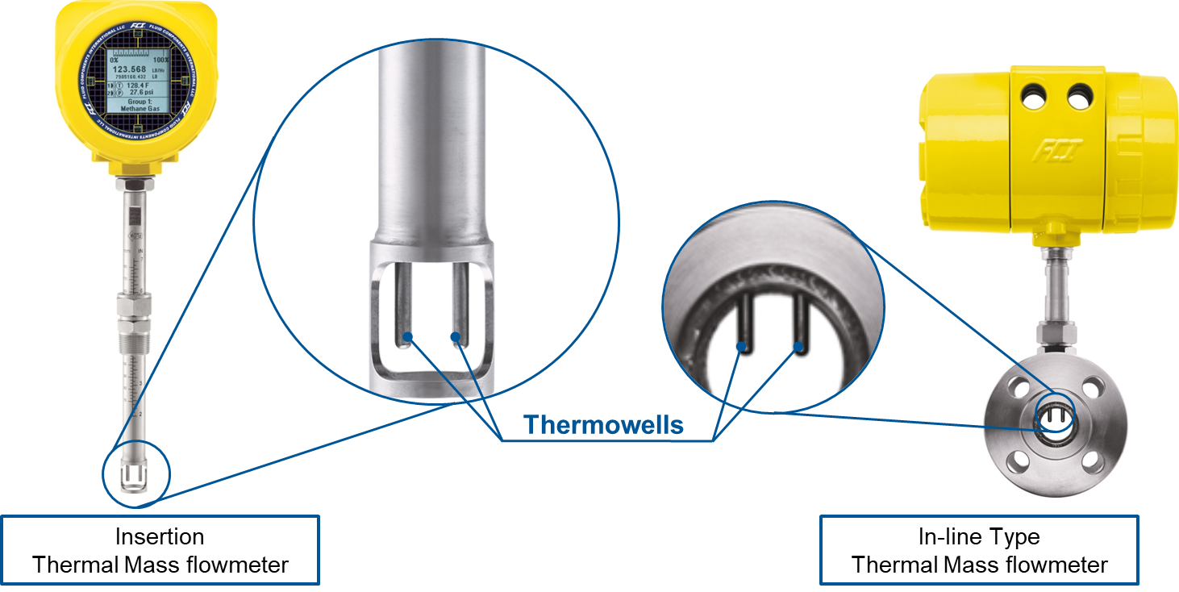
Basic Thermal Sensors
Primary Components: (2) Sheathed RTDs
  No Moving Parts

Slide 7
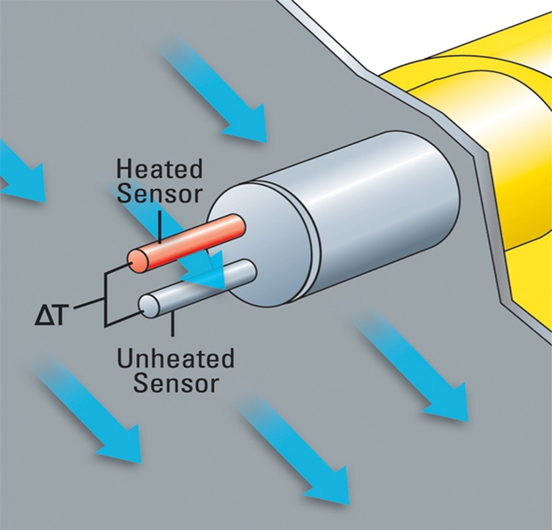
Thermal: Think “Delta T”
By heating one of the RTDs, a temperature differential (ΔT) is created

Slide 8
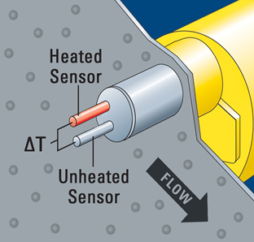

Media “Cools” the Sensor
Thermal technology measures the cooling effect of a fluid as related to ΔT
  Cooling is related to the velocity, density, thermal conductivity and other attributes of the media being measured

Slide 9
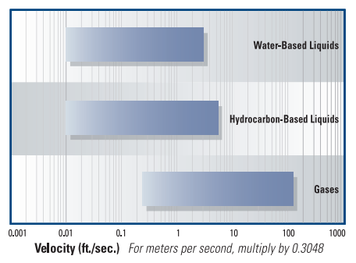
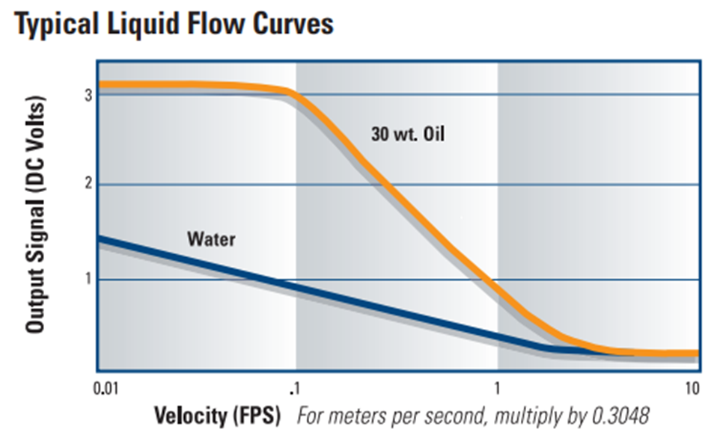
Thermal Switches have Broad Flow Range Capabilities
Adjustable Flow Range is Dependent on Process Media
  Thermal Technology is Suitable for Liquid & Gas Flow Switch Applications
    Liquids: 0.1 to 5.0 fps
    Gases: 0.25 to 120 SFPS
  Thermal conductivity of a process media will impact the flow curve of a liquid

Slide 10
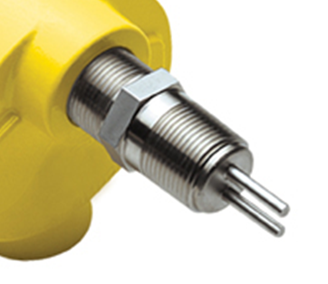
Benefits Associated with Thermal Switch Technology
Positive Attributes of Thermal Switches
  Reliability (No Moving Parts)
  Very Repeatable
  Low Flow Capabilities
  Flexible Orientation on Pipe/Duct
  In-Situ Calibration
  Operation Easily Verified
  Fail-Safe Configuration Capabilities
  Suitable for Hazardous Areas, IEC 61508/61511 (SIL 2) and Nuclear applications

Slide 11
Mass Flow Metering Technologies
Two Recognized & Accepted Mass Flow Measurement Technologies
  Coriolis: Liquids & Gases
  Thermal: Gases
Neither Requires Pressure/Temperature Compensation to Provide Mass Flow Measurement
  DP, Ultrasonic, Vortex, and Turbine are Volumetric
    Note: Multivariable simplifies the P/T integration for the use of DP technology in Mass Flow Measurement

Slide 12
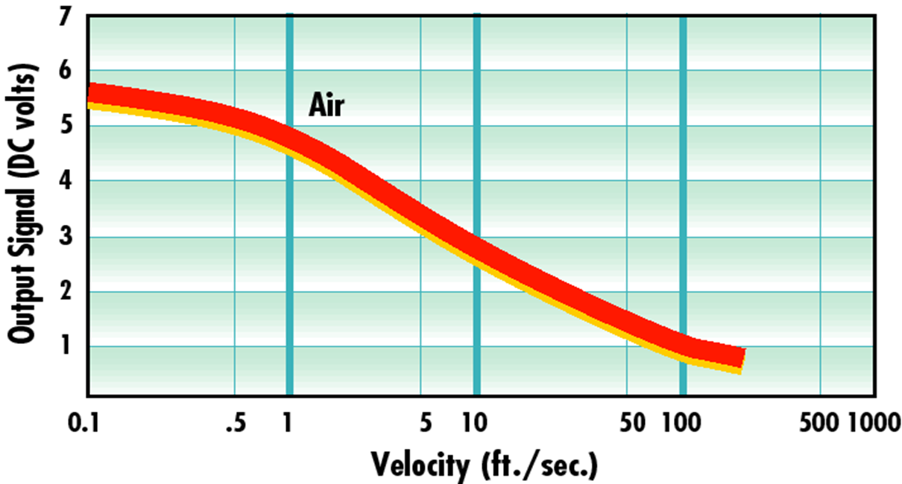
Flow Metering is Commonly Limited to Gas Applications
Broader Velocity Curve is Better Suited to Linearization
  Minimum Velocity as low as 0.25 SFPS
  Maximum Velocity around 600 to 1,000 SFPS

Slide 13
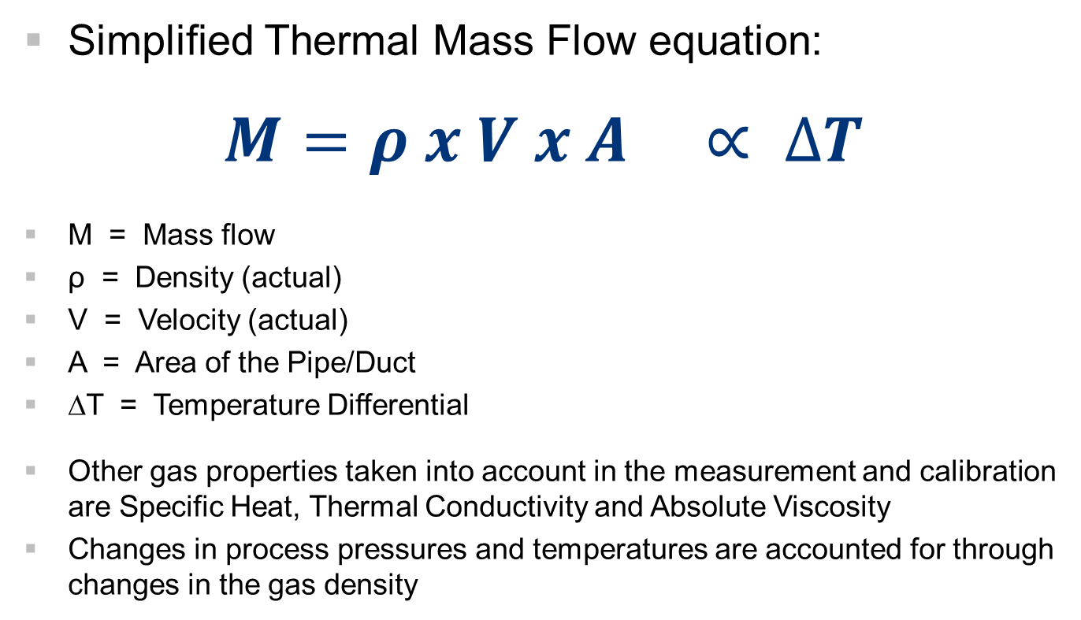
Relationship Between Mass Flow and ΔT
Simplified Thermal Mass Flow equation:
$$M=ρ x V x A ∝ ∆T$$
M = Mass flow
ρ = Density (actual)
V = Velocity (actual)
A = Area of the Pipe/Duct
∆T = Temperature Differential
Other gas properties taken into account in the measurement and calibration are Specific Heat, Thermal Conductivity and Absolute Viscosity
Changes in process pressures and temperatures are accounted for through changes in the gas density

Slide 14
Methods of Powering a Thermal Sensor
Constant Power (CP):
  A fixed current is applied to the heated RTD; ΔT will decrease as flow increases, increase as flow decreases
    Mass Flow is proportional to the change in ΔT
  Supports measurement of higher flow rates and is less susceptible to false high readings due to condensation/entrained moisture (passive circuit naturally dampens the signal)
Constant Temperature (CT):
  A variable current is applied to the heated RTD in order to maintain a constant temperature differential between the heated and unheated RTDs
    Mass Flow is proportional to the amount of current required to maintain ΔT
  CT provides faster response time than CP
    Caution: Tends to “overshoot” flow value initially, so dampening of output signal may be required
Newer “Hybrid” adaptive sensor technology
  Combines the benefits of CP and CT technology into a single instrument

Slide 15
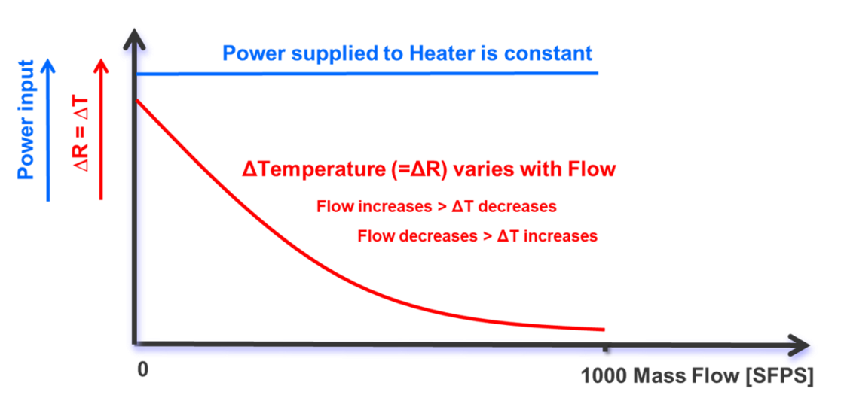
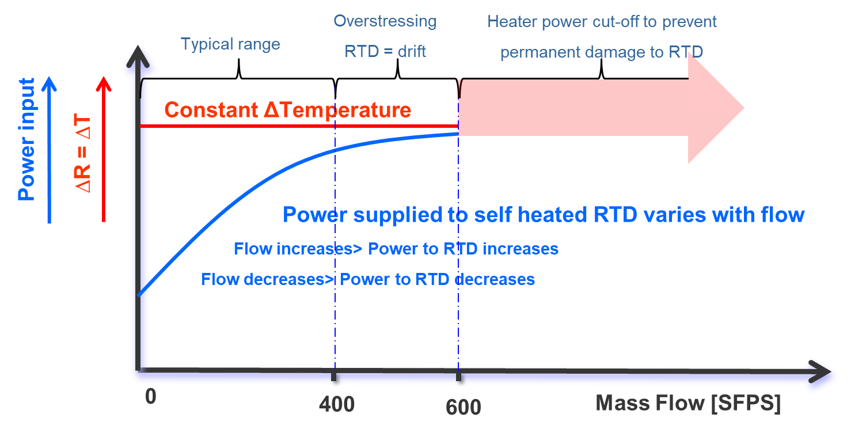
Relationship Between Power & ΔT
Constant Power (CP)
Constant Temperature (CT)

Slide 16
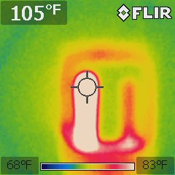
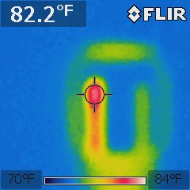
Thermal for Explosive Gases? Yes!
The amount of energy introduced into a process gas is small in comparison to the volume of media being measured
CP Sensor
105°F [40.6°C]
∆T: 26°F [14.5°C]
CT/Hybrid Sensor
82.2°F [27.9°C]
∆T: 6.6°F [3.8°C]

Slide 17
3rd Party Approvals & Ratings for Hazardous Areas and Gases
Approvals
  FM/FMc are common to most manufacturers
    Class I/Div 1, Groups BCD
    Class II & III/Div 2, Groups EFG
    Class I/Div 2, Groups ABCD
    Class II/Div 2, Groups EFG
T-Ratings
  Example: T4 Ta= -40°C to 60°C

Slide 18
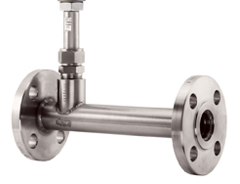
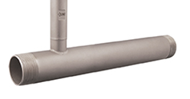
In-Line (Spool) Design
For line sizes 2 inch or smaller, it is common to use an In-Line (Spool) design
  In-Line models are calibrated as a unit to ensure accuracy in the field
    Eliminates errors related to improper insertion depth and rotation of the sensor
    Minimizes permanent pressure loss related to sensor blockage
  Commonly available with NPT, Flanged or Butt Weld process connections

Slide 19
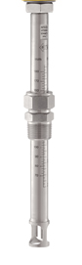
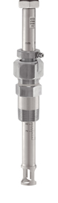
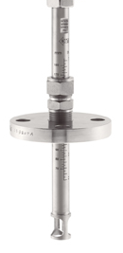
Insertion Design
For line sizes 2-1/2 inch or larger, the preferred design is Insertion
  Smaller errors related to insertion depth and rotation of sensor
  More economical installation, eliminating the need for any bypasses
  Commonly available with NPT, Compression Fittings, Packing Glands and Flanges

Slide 20




Insertion: Sensor / Head Types
Optimized Sensors Exist for Gas Applications
      Conditioned for Compressed Air/High Pressure
      Faster Response in Clean/Dry Gases
      Designed for More Corrosive/Wet Media
      Shrouded for Wet Gas (not Dual-Phase)

Slide 21
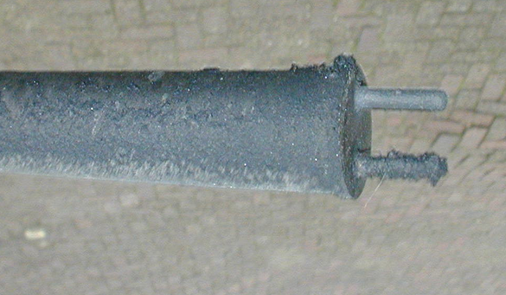
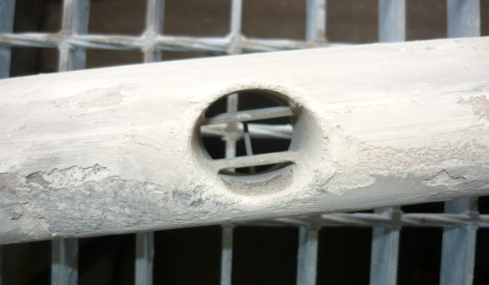
Thermal Sensors Work in Particulate Laden Gas Streams
Unlike most technologies, Thermal technology will continue to provide measurement in applications that have particulate in the gas stream
  Build up is typically site dependent and can be addressed through preventative maintenance

Slide 22
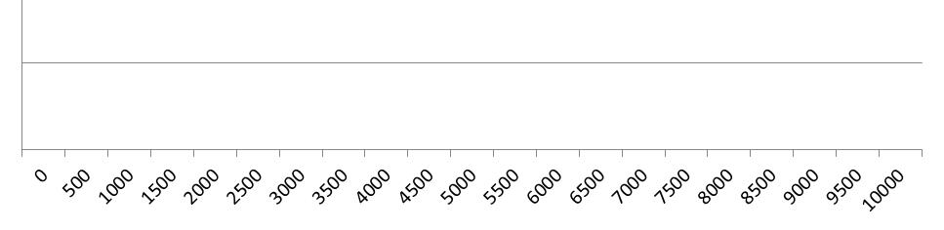
Maximize Your Turndown Ratio
Example:
  Media: Nat Gas
  Accuracy: ± 1.0% Reading, ± 0.5% Full Scale
  Flow Range: 0 to 10,000 SCFM
  Thermal allows for Pilot & Normal flow rates
    Boilers, Burners, Flares, etc.
Thermal: 100 to 10,000 SCFM (100:1)
DP w/ Orifice: 2,000 to 10,000 SCFM (5:1)
Nat Gas Flow, SCFM

Slide 23
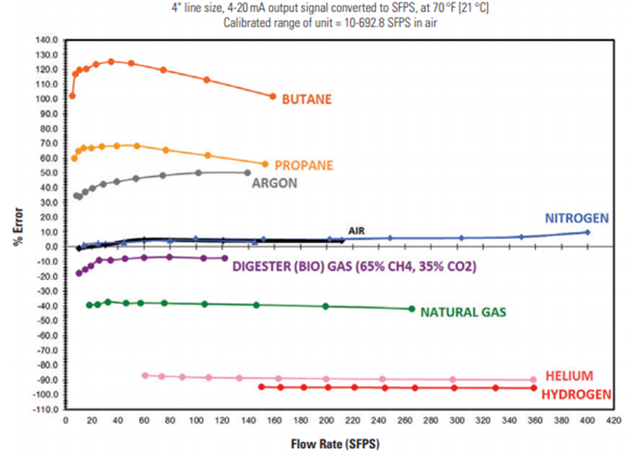
Optimize Calibrations to Match Actual Gas Conditions
Equivalencies v Actual Gas Calibrations
  Calibrations should match Media and Pressure/Temperature conditions when possible

Slide 24
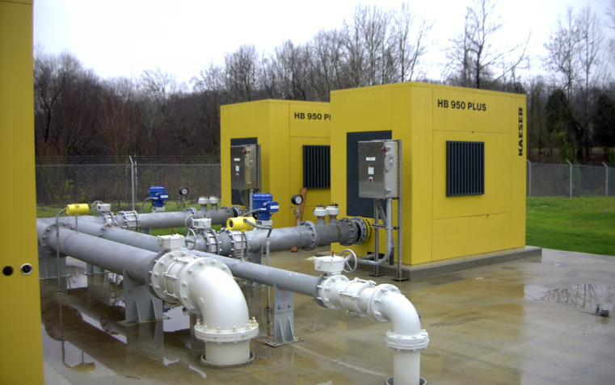
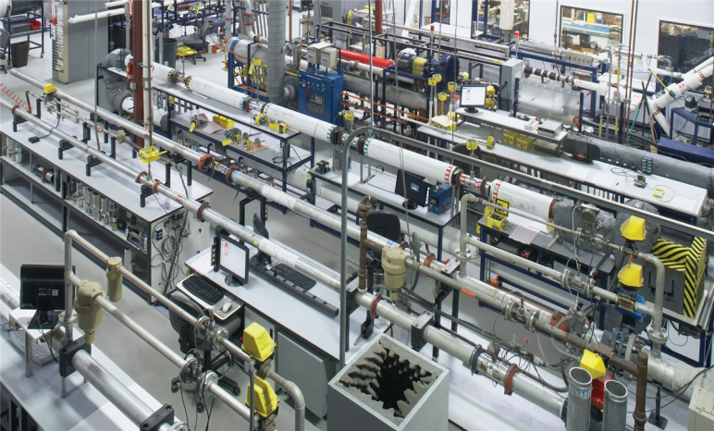
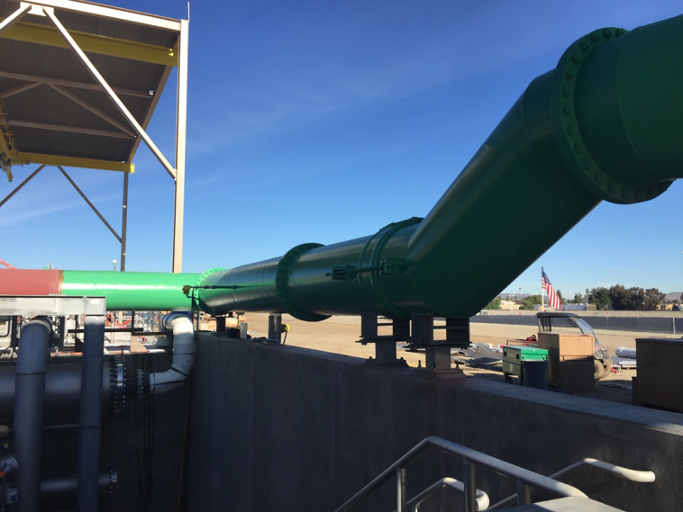
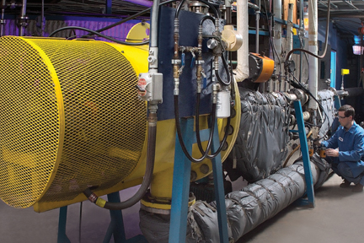
Factory Calibration v Actual Field Conditions
Ideal World
Real World

Slide 25
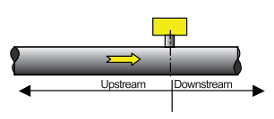
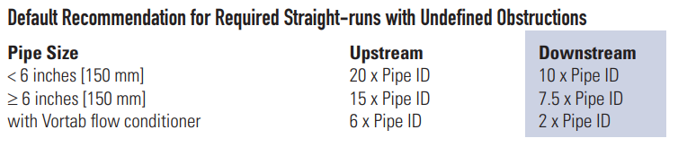
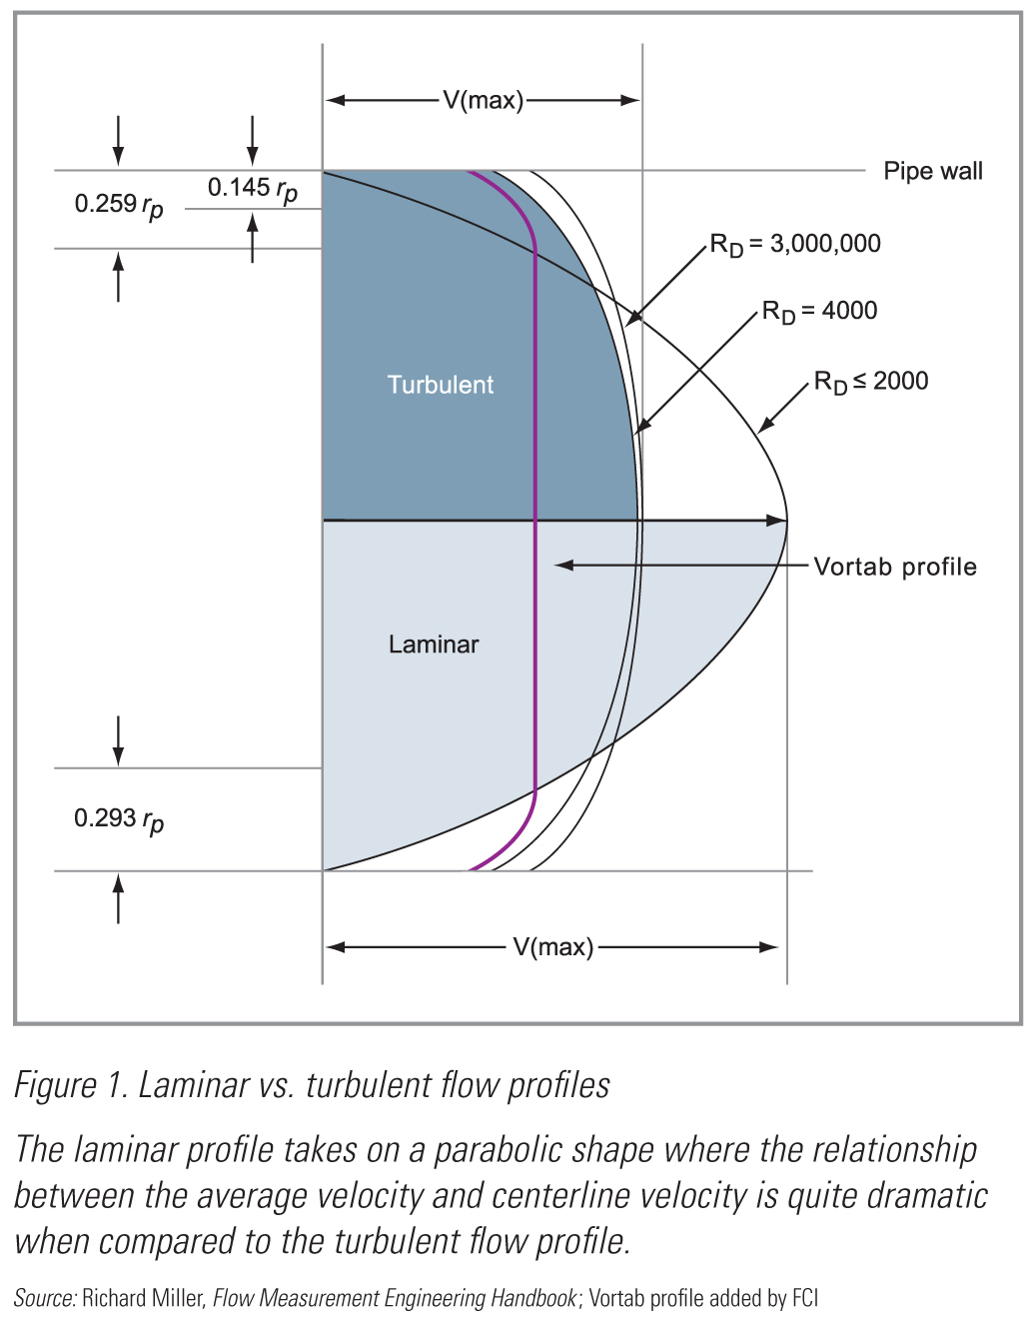
Fully Developed Flow Profiles

Slide 26
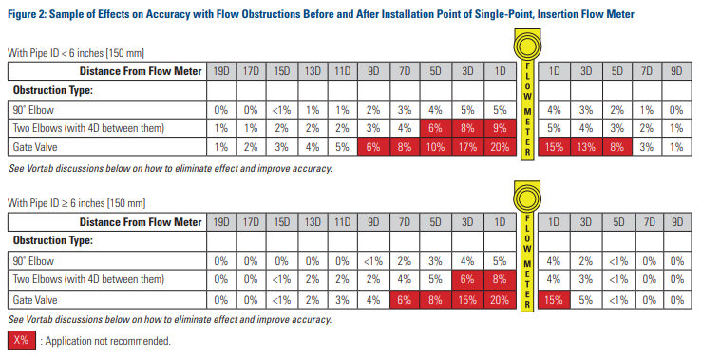
Examples of Accuracy Based on Location of Common Obstructions
Straight Run limitations affect accuracy, not repeatability

Slide 27
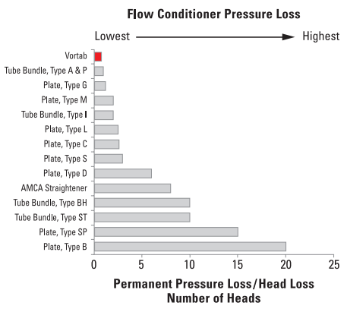
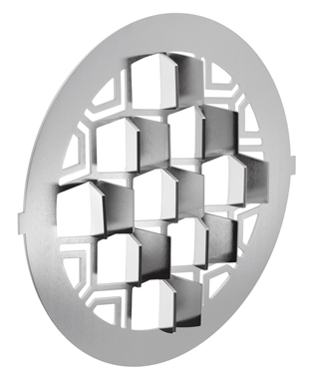
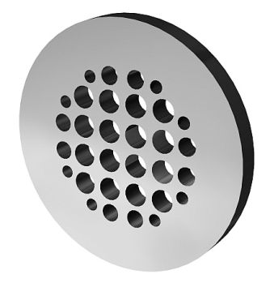
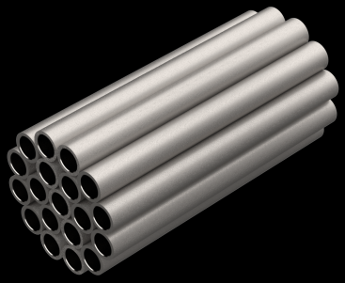
Applying Flow Conditioners
Low v High Pressure Loss Designs
Address Your Specific Condition: Velocity, Swirl
Value is provided when a flow meter is calibrated to the unique flow profile of the flow conditioner

Slide 28
Installation, Maintenance and Cost of Ownership

Slide 29
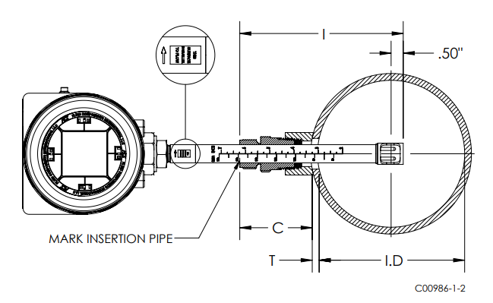
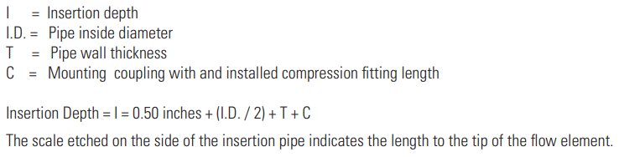
Thermal Insertion Meters
Installation Details

Slide 30
The Challenge of Measuring “Wet” Gases
A gas that either contains water vapor in percentages that exceed the saturation point are considered to be ‘wet’ gases
  A state of saturation exists when the air/gas is holding the maximum amount of water vapor possible at the existing temperature and pressure.
  Liquid vapor saturation is no greater than 10%
    Above 10% would be considered a two phase/dual phase composition
Air/Gas is not conditioned at measurement point due to:
  Desired Metering Location
  Costs associated with drying and cleaning gases
Typical Conditions
  Moisture flowing in same direction as gas (Entrained)
  Moisture flowing in opposite direction from gas (Ambient)
  Condensation formed on the wall of the pipe/duct

Slide 31
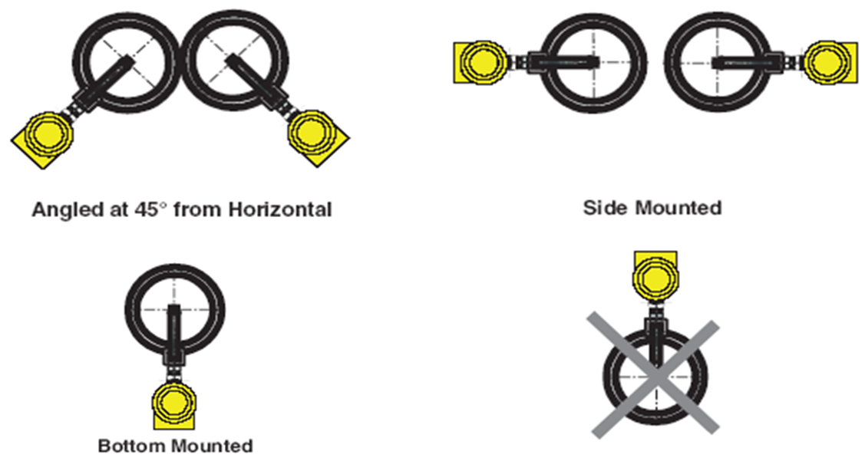
Installation Recommendations for Presence of Moisture
When either pipe wall condensation or entrained moisture is present, top mounting of instrument is not recommended

Slide 32
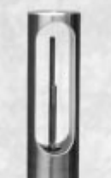
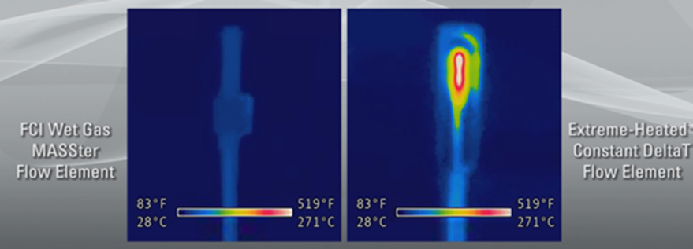
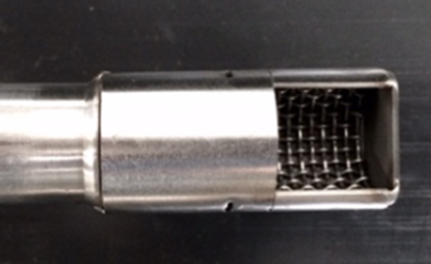
Special Purpose “Wet Gas” Flow Meters
Method 1: Mechanically shunt the condensate away from sensor
  Safety approvals are maintained, no increase in energy consumption, and no impact on the sensors’ service life.
Method 2: Increase the Constant Temperature (CT) to 572°F
  Intended to “flash off” any moisture
    Extreme temperature may create un-safe condition, consumes much more energy, and may result in premature sensor failure

Slide 33
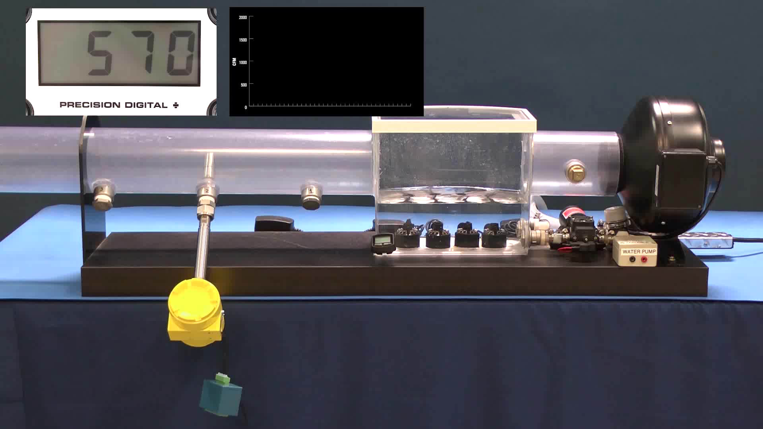
Moisture Shield - Validation Test Equipment
Notes:
Hit arrow to play video.

Slide 34
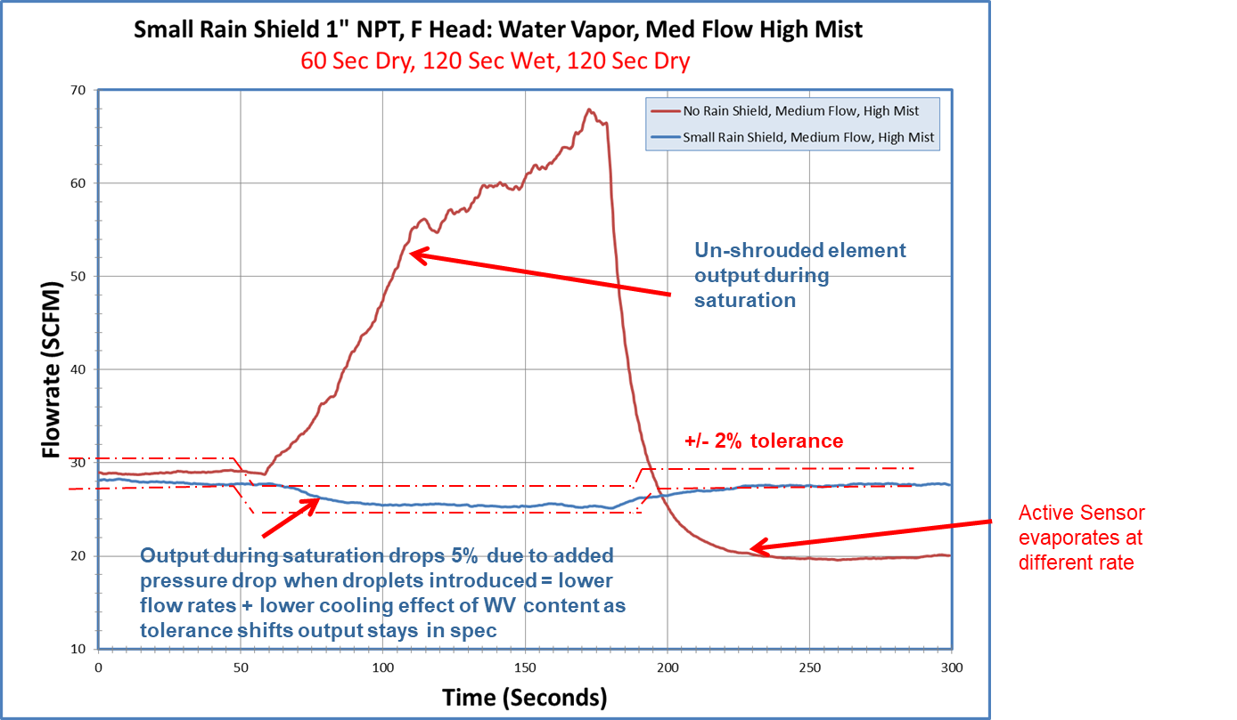
Flow Indication of Wet Gas Sensor v Standard Sensor
xxx

Slide 35
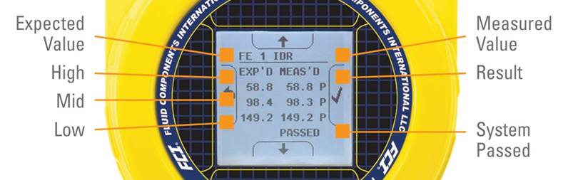
Most Thermal Meters Have a Validation/Verification Feature
Validates the electronics to determine if out of acceptable tolerance
  Does not validate the sensor
    Separate Sensor Checks can be made

Slide 36
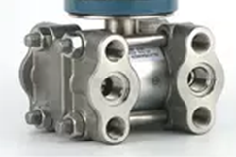
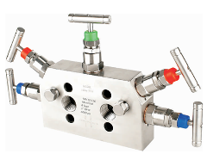
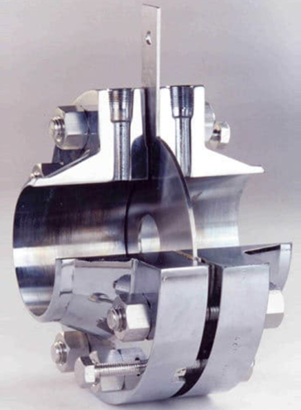
Why Continue Using Differential Pressure w/ Orifice for Mass Flow Measurements?
Positive Attributes of DP/Orifice
  Accuracy/Repeatability
  Loop Powered
  Experience w/ Technology & Maintenance
  Suitable for Gas, Liquid & Steam Applications
Negative Attributes
  Limited Turndown Ratio
  Permanent Pressure Loss
  Impulse Tubing (Potential for Plugging)
  Complex Manifold Valves
  Need to Calibrate DP, Pressure & Temperature Transmitters (Mass Flow Applications)
  Remove Orifice for Inspection (Verify Clean, Sharp Edge)
  Higher Installed Costs & Overall Cost of Ownership

Slide 37
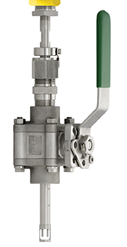
Thermal is Better Suited to Gas Mass Flow Measurements
Positive Attributes of Thermal
  Mass Flow Technology
  Accuracy/Repeatability
  Wide Turndown Ratio (100:1 Typical; 1,000:1 Option)
  No Moving Parts
  Very Low Permanent Pressure Loss
  Simple Isolation from Process
  Operation Easily Verified
  Lower Installed Costs & Cost of Ownership
Negative Attributes
  Calibration Dependent Upon Gas Composition
  Not Loop Powered
  Suitable Only for Gas Applications

Slide 38
Example: Cost of Ownership
DP or MV with Orifice (Mass Flow) v Thermal
Energy loss based on a blower producing 8 psig @ 250 KW, 8,000 hours of operation at a cost of $0.15 /KWH
Pressure loss at Max Flow: DP/MV ~ 25” w.c., Thermal ~ 8” w.c.

Slide 39
Thermal Multipoint Averaging Mass Flow Meters

Slide 40
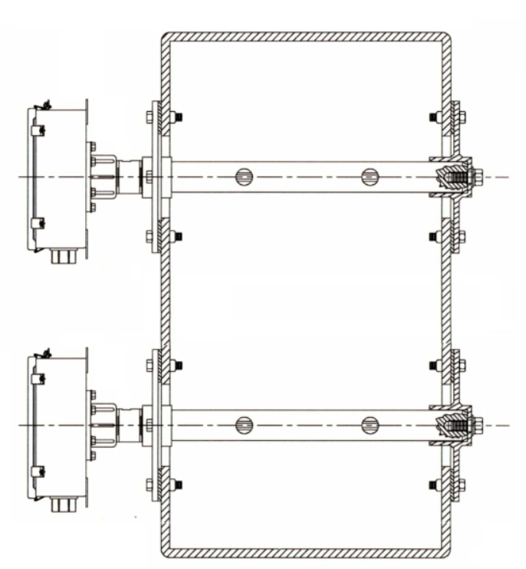


Why a Multi-Point Meter Over a Single Point?
Larger line sizes have additional error related to the cross sectional area and often involve limited straight run
Multi-point Duct installation
Multi-point stack installation
Single-point stack installation

Slide 41



Examples of Multipoint Averaging Systems
May utilize a combination of single point sensors or specifically designed elements with multiple sensors

Slide 42
For more information and discussion of your application, contact your Gilson Engineering sales engineer.

Slide 43
www.FluidComponents.com

